Slide 1


COLLEGE ADMISSION PROJECT
PYTHON
1

Slide 2

by: DEVI PRIYA.G - E0320016
FACULTY :
PROF.V.RAGAVAN

Slide 3
AIM
To find whether the student has got admission or Not.

Slide 4
DESCRIPTION
The columns involved are:
Admit
GRE
GPA
SES
Gender
Race
Rank

Slide 5
explanation
ADMIT:- ALLOW SOMEONE TO ENTER A PLACE (COLLEGE)
GRE:- GRADUATE RECORD EXAMINATION The Graduate Record Examination, or GRE, is an important step in the graduate school or business school application process. The GRE is a multiple-choice, computer-based, standardized exam that is often required for admission to graduate programs and graduate business programs (MBA) globally. The graduate record examination (GRE) is a standardized exam used to measure one's aptitude for abstract thinking in the areas of analytical writing, mathematics, and vocabulary. The GRE is commonly used by many graduate schools in the U.S. and Canada to determine an applicant's eligibility for the program.

Slide 6
explanation
GPA:- GRADE POINT AVERAGE The full meaning of GPA is Grade Point Average, which is a grading system. This grading system is used to measure a student's performance in an educational session. Your GPA, or Grade Point Average, is a number that indicates how well or how high you scored in your courses on average. It's meant to score you (usually on a GPA scale between 1.0 and 4.0) during your studies and shows whether your overall grades have been high or low.
SES:- SUPPLEMENTAL EDUCATIONAL SERVICES Supplemental educational services (SES) are tutoring and other academic enrichment activities provided outside of the regular school day to eligible public school students to help improve achievement in reading, language arts, and math.
GENDER_MALE:- It represents the male candidates.
RACE:- The term race refers to groups of people who have differences and similarities in biological traits deemed by society to be socially significant, meaning that people treat other people differently because of them.

Slide 7
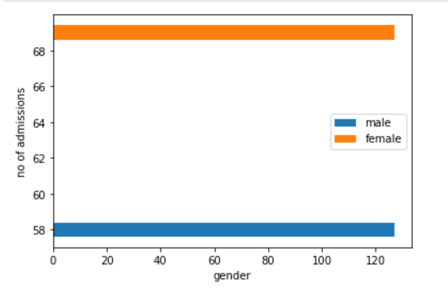
GRAPH BETWEEN GENDER AND NO.OF ADMISSION SECURED
From this graph we can infer that , The number of admissions obtained by the female students is greater than that of the male students

Slide 8
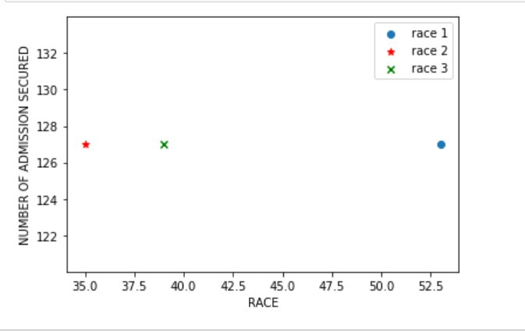
Graph between race and no . of admission secured
From this graph we can infer that, Students from race 1 have obtained maximum admission followed by race 3 and race 2

Slide 9
Problem statements
Classify the students based on rank.
Find the number of students who got admission with the rank 1,2,3 and 4 separately.
Print the total number of admissions given
Print number of students with highest and lowest grade
Print the number of students with highest gpa with their details.
Filter students with gpa score above 3
Check whether the data set has nan values
Find the maximum and minimum gpa score obtained by the students
Find the average gre score obtained by the students

Slide 10
conclusion
From the problem statements we have discussed, we can conclude the following:
Maximum number of students who applied for admission have obtained 2nd rank
54 students have secured admission by obtaining 2nd rank followed by 33 students by obtaining 1st rank, 28 students by obtaining 3rd rank and 13 students by obtaining 4th rank
127 students have managed to secure admission out of 400 students
61 students have obtained 1st rank while 67 students have obtained 4th rank.
28 number of students have obtained a maximum gpa score of 4

Slide 11
Machine learning model
For the dataset given above, logistic regression model can be applied as the final output can either be yes or no ,that is the student has secured admission or has not secured admission svm model can not be applied as it can be applied only when there are multiple possibilities of output. Thus, logistic regression machine learning model is used for college admission dataset

Slide 12
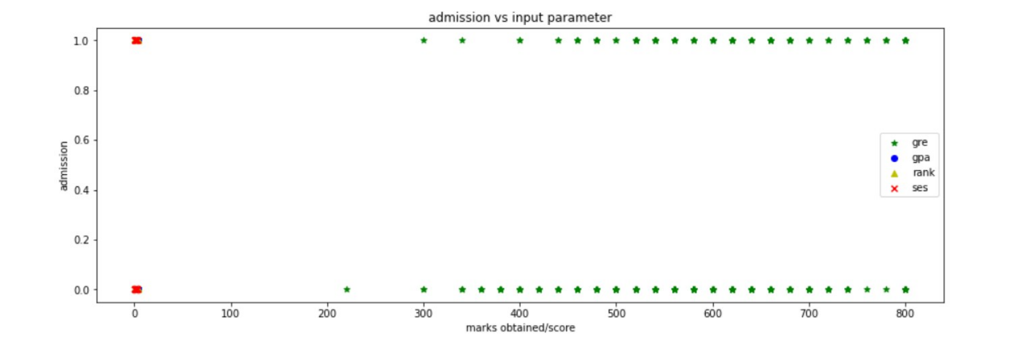
Admission vs input parameter
From this graph we can infer that, the admission process is based on gpa score , gre score , rank and ses .

Slide 13
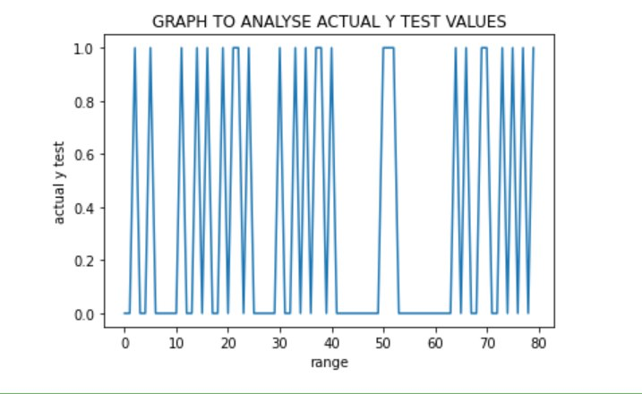
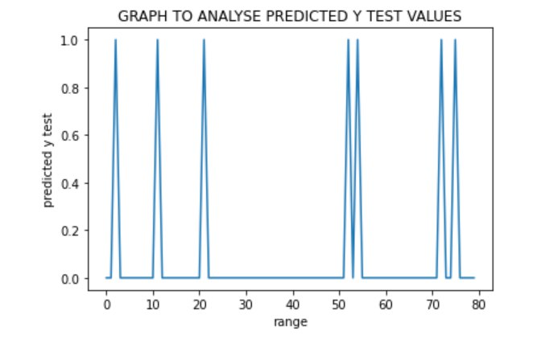
result
Comparison between actual y test values and predicted y test values.

Slide 14
Conclusion
From the above graph, the accuracy score for predicted y test values from x test and actual y test values is 75%

